Slide 1
Computer Systems and Networks
ECPE 170 – University of the Pacific
Midterm Exam
OCT 16th

Slide 2
Midterm Exam
Part 1 (25%)
Part 2 (75%)
Paper & Pencil only
No computer, no notes, no Internet, etc…
When finished, turn in paper and obtain part 2
With Computer
Open notes, open Internet
Not allowed: communication with classmates!
You can choose how much time to allocate to Part 1 versus Part 2, but a safe goal is to leave 1 hour for Part 2

Slide 3
Midterm Exam – Part 1
Format: Short answer questions
A few words up to a few sentences
Content
All class material up through end of Lab 6
Study Tips
Review lecture slides
Review questions asked in lab reports

Slide 4
Midterm Exam – Part 2
Format: Perform “lab-like” activities
Utilize version control?
Create a Makefile?
Profile a program for CPU utilization?
Use Valgrind to identify a memory leak, and then fix it?
You will only be given a text description of the problem
You determine the right command(s) to use
Study tip: Know where to quickly find the right command

Slide 5
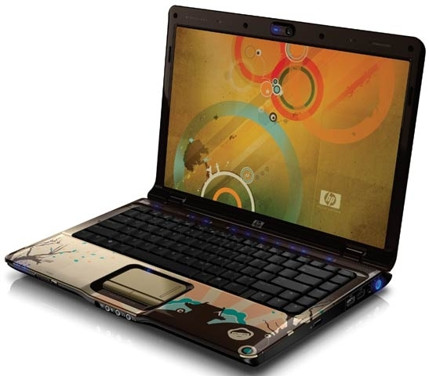
Bring Laptop!
** Bring your Linux system to the midterm! **

