Slide 1
Computer Systems and Networks
Lecture 3: Version control systems
Dr. Pallipuram (vpallipuramkrishnamani@pacific.edu)
University of the Pacific

Slide 2
Lab Schedule
Today
Lab 2 – Version Control
Next Week
C programming
Lab 3 – Build Tools

Slide 3
Before Version Control
<Report.doc>
<Report.doc.bak>
<Report-1.doc>
Email off to partner…
<Report-2.doc>
Partner responds with doc (that is missing the changes you just made)
<Report-2a.doc>
<Report-2a-WITH-REFERENCES.doc>
Email off to partner… Partner responds with new doc <Report-3.doc>
<Report-3-FINAL.doc>
<Report-3-FINAL_v1.doc>
Report-3-FINAL_v2.doc>
Report-3-FINAL_forsure.doc>
Report-3-FINAL_forsure_v1.doc>

Slide 4
Motivation for Version Control
Why would a single programmer (working alone) use version control?
Backup files
Roll-back to earlier (working) version
See changes made between current (broken) code and earlier (working) code
Experiment with a new feature
Try a risky change in a “sandbox”
If it works, you can merge it into the regular code. If it fails, you can throw it away.

Slide 5
Motivation for Version Control
Why would a small group of developers use version control?
All the reasons a single programmer would, plus…
Merging different changes made by different developers into the same file
Mercurial keeps track of it using the concept of changesets
What changed? where? Moved where in the file?

Slide 6
Motivation for Version Control
Why would a large group of developers use version control?
Different question: Could you develop the Linux kernel, Adobe Photoshop, Google Chrome, etc… using:
A single shared “folder of code”?
Emailing code snippets between developers?
Everyone sits around and shares one keyboard?

Slide 7
Version Control Basics
What kind of files should I keep in version control?
Program source code (obviously)
VHDL / Verilog files (from digital design class)
Matlab scripts
HTML files
Server configuration files
Imagine you work at Livermore National Labs, and your job is to manage Linux cluster computers with 100,000+ machines (nodes)…
Anything that is plain text!

Slide 8
Version Control Basics
What kind of files should I not keep in version control?
These aren’t “rules”, so much as “guidelines”…
Binary data
How do you merge two different binary files together? No general-purpose way to do this
Anything auto-generated by the compiler
Object files or executable file
Wastes space on useless junk that can be re-created automatically
Text editor temp files (e.g. main.c~)

Slide 9
Problem 1: How are these VCSs different? Google ‘em!
Mercurial
Git
SVN

Slide 10
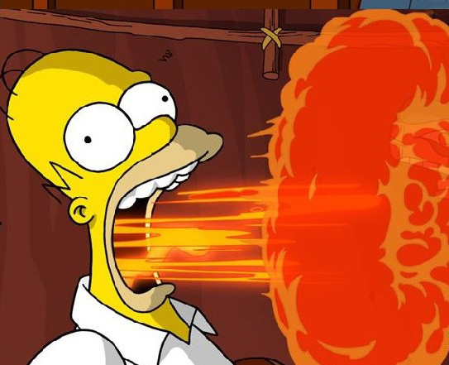
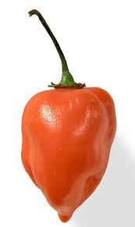
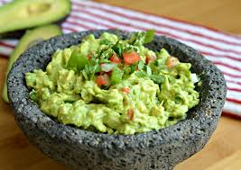
Universe 1: Centralized Version Control SVN
Centralized Repository
svn commit
Ivan’s Dir
Lisa’s Dir
Kevin’s Dir
Dorothy’s Dir
Notes:
Ivan’s recipe: avacado with jalapenos
Oops! Ivan pushed habanero’s instead! It got into the central repository. All download crazy hot guac! Gaaah!

Slide 11
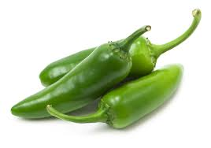
Universe 2: Distributed Version Control Hg
Centralized Repository
hg push
hg pull
Ivan’s Repo
Lisa’s Repo
Kevin’s Repo
Dorothy’s Repo
hg commit
Ivan’s Dir
Lisa’s Dir
Kevin’s Dir
Dorothy’s Dir
Notes:
Ivan committed a recipe with habenero. No issues, it was not pushed to the central repository yet
He corrects the recipe (replaces habanero with jalapenos), commits it (to his repo), and pushes it (to central repo)
All ‘pull’ the correct recipe

Slide 12
Mercurial Command Flow (usually)
hg clone <repository address>
#get repo on your desktop
hg add <filenames> #always specify a filename to add
#add new files and make changes
hg commit -m <meaningful commit message>
#commit to your repo
Make changes and repeat 3
hg revert –all
#if not happy with changes, revert to last commit (do 4)
Then make changes and go to 3
hg push #All done? Let everyone see

Slide 13
Problem 2: Google Search for Mercurial Cheat Sheet(s)

Slide 14
Version Control in ECPE 170
Version control required for this class
Used to distribute boilerplate code for labs
Used to turn in assignments when finished
If you only do one check-in at the very end of your project, you've missed the whole point of version control, and turned a valuable tool into an obstacle to completing the assignment
Check-in code on a regular basis!

Slide 15
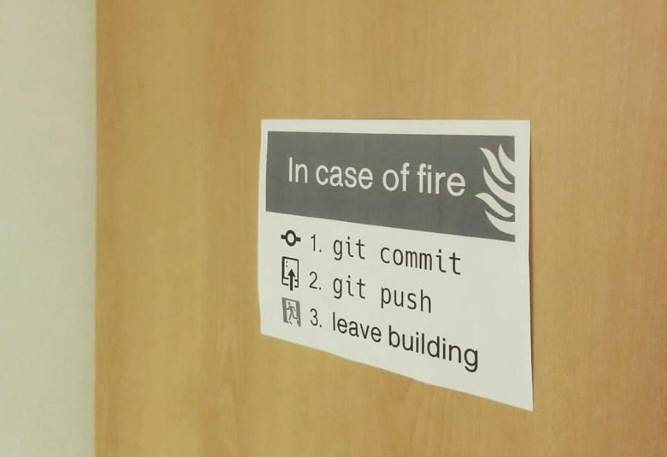
hg
hg

Slide 16
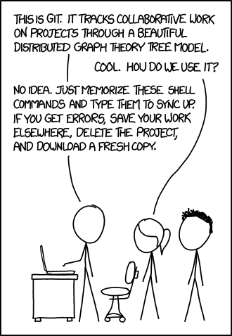

Slide 17
In-class Participation
Collaborate with only one class member to answer in-class participation questions

Slide 18
Work for another half hour then we’ll call it a day!
Notes:
You may want to adjust this work time for your class as desired

Slide 19
http://hginit.com/00.html
Notes:
Great blog on mercurial

