Slide 1
Computer Systems and Networks
Lecture 5: C Programming
Dr. Pallipuram (vpallipuramkrishnamani@pacific.edu)
University of the Pacific

Slide 2
Please read Lab 4 Description

Slide 3
Today’s Class
Pointer basics
Pointers and multi-dimensional arrays
malloc, calloc, free
2D array manipulation for Lab 4
Strings in C

Slide 4
Pointers are special variables that hold/store memory addresses of other variables.
When a pointer, say iptr, holds the address of an integer variable, say ivar, then we say: “iptr is an integer pointer that points to ivar.”
int ivar=45;
int *iptr; iptr = &ivar; //iptr points to ivar
ivar:
45
iptr:
65536
address: 65536
address: 65520
‘&’ is ‘address of variable’ operator. For example, &ivar translates to: “address of variable ivar”.
‘*’ is ‘value at address stored in pointer’ operator. For example, *iptr translates to: “value at address stored in pointer iptr”.

Slide 5
We can have a ‘multiple’ pointer
Example pointer declaration:
int *iptr; //an integer pointer that will point to an integer
int **dptr; //A double pointer that will point to an integer pointer
int ***tptr; //A triple pointer pointing to a double pointer.
int ****quadptr //___________________________________

Slide 6
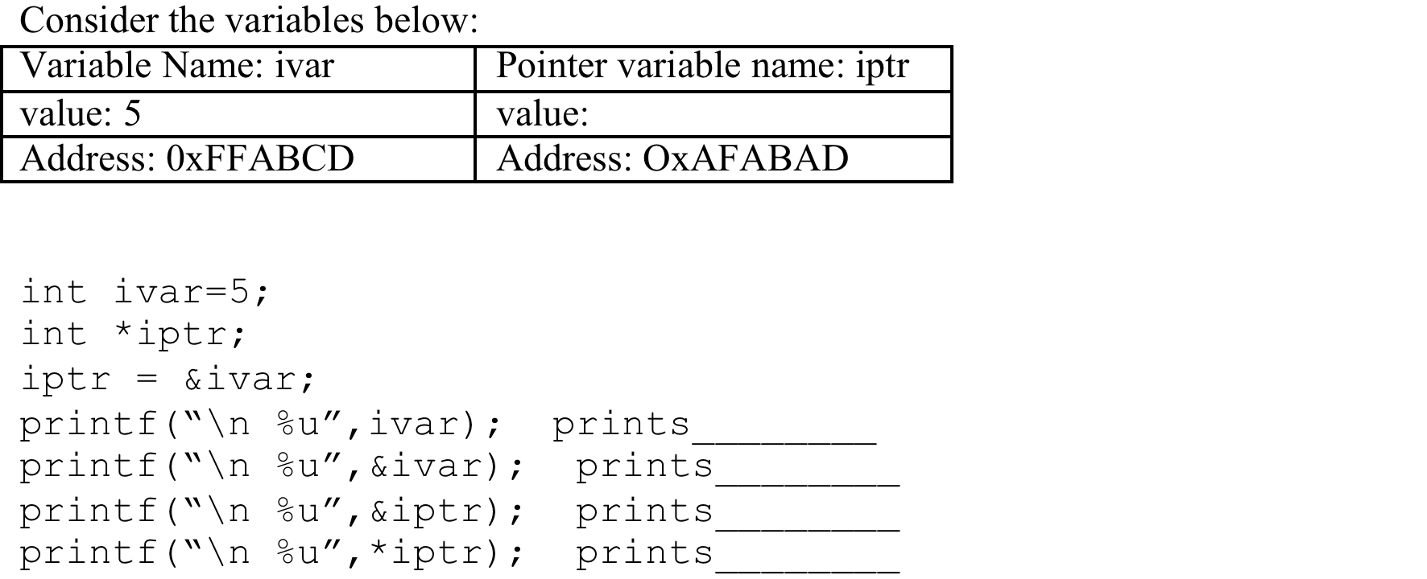
Problem 3

Slide 7
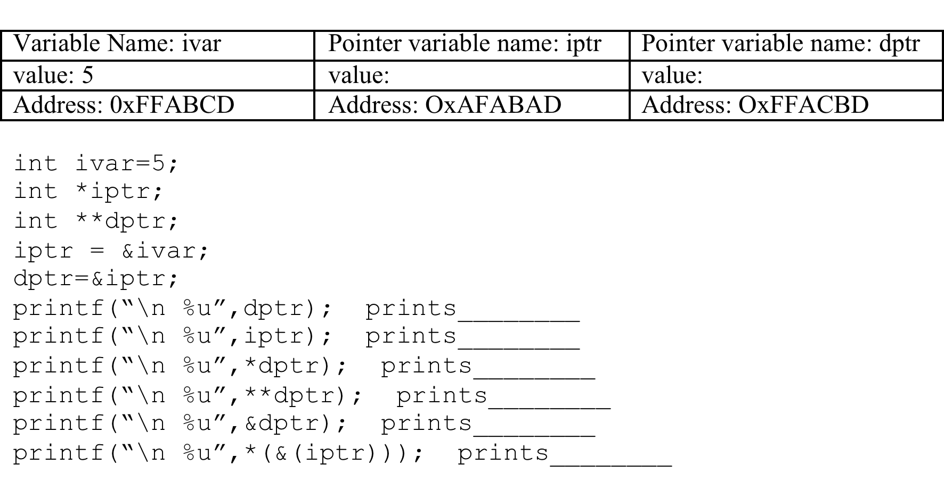
Problem 4

Slide 8
Pointer Arithmetic
Only addition and subtraction are allowed with pointers.
All pointers increase and decrease by the length of the data-type they point to.
Example: If an integer pointer, iptr holds address 32, then after the expression iptr++,
iptr will hold 36 (assuming integer is 4 bytes).

Slide 9
Two methods of traversing 1-D array
Pointer Method
Subscript Method
for (i=0;i<arraysize;i++)
*(array+i)=*(array+i)+1;
//iterates through the array and increments contents by 1
for (i=0;i<arraysize;i++)
array[i]=array[i]+1;
//iterates through the array and increments contents by 1
More intuitive

Slide 10
Pointers and Functions: Call by value vs. Call by reference
Call by value
Call by reference (pointer)
these are just copies. No change to original variables
main(){
a=5,b=6;
update(a,b);
printf(“%d”,a);
}
update(int a, int b) {
a=a-b;
}
main(){
a=5,b=6;
update(&a,&b);
printf(“%d”,a);
}
update(int *a,int *b) {
*a=*a-*b;
}
modification
to actual variable

Slide 11
Example: Modify array values using function call
main(){
//assume int array a of size 5
update(a,5); //name of array is starting addr.
}
update(int *a,int size) {
int i=0;
for(i=0;i<size;i++)
a[i]++;
}

Slide 12
Malloc – 1D
int *array; //array of integers
array = (int *)malloc(sizeof(int)*5);
address:
60 | 64 | 68 | 72 | 76
array[0] | array[1] | array[2] | array[3] | array[4]
value:
array (pointer variable)
value: 60
pointer’s addr: 32

Slide 13
Malloc – 2D Allocate 4x5 integers (important for lab 4)?
int **array; //a double pointer
array = (int **)malloc(sizeof(int *)*height);
for(i=0;i<height;i++)
array[i] = (int *)malloc(sizeof(int)*width);
array of ints
array of ints
array of ints
array of ints
an array of integer pointers

Slide 14
Malloc – 3D
int ***array; //a triple pointer
a ‘cuboid’ of integers
an array of
double pointers
a matrix of
single pointers

Slide 15
Calloc()
void * calloc(int count, int size)
Basically the same as malloc!
Imagine you want an array of elements…
Argument 1: # of elements to allocate
Argument 2: Size of each element in bytes
Return value: Pointer to the region

Slide 16
Realloc()
void * realloc(void *ptr, int size);
Resize a dynamic region of memory
Note that it might move to a new address!
Argument: Pointer to the original region
Argument 2: Desired size in bytes of new region
Return value: Pointer to the new region
It might be at the same address if you made it smaller
It might be at a new address if you made it larger

Slide 17
#include <stdlib.h>
Include this library to use malloc, realloc, and calloc!

Slide 18
C Structures
Structures are a nice way to bring certain related items together
struct database
{ int id_number; int age; float salary; };
int main()
{
struct database employee; //an object
employee.age = 22;
employee.id_number = 1;
employee.salary = 12000.21;
}
structure objects access members using dot operator

Slide 19
Problem 2 (Important for Lab 4)
Declare a structure called board that contains: a double character pointer matrix, two integer variables height and width denoting the number of rows and columns in the matrix. Inside main, do the following:
create a structure object called myboard, initialize matrix to NULL, set height to 7 and width to 7.
Dynamically allocate matrix to hold height x width elements

Slide 20
Traversing 2D array
main(){
//Assume a is dynamically allocated 2D array
update(a,5,5); //name of array is starting addr.
}
update(int **a,int height,int width) {
int i=0,j=0;
for(i=0;i<height;i++)
for(j=0;j<width;j++)
a[i][j]++;
}

Slide 21
Problem 3 (Useful for Lab 4)
Refer to Problem 2. Traverse the 2D matrix of dimensions height (rows) and width (columns). Find the first instance of small letter ‘e’. Obtain all the letters starting from ‘e’ placed diagonally downwards in this matrix. Store the letters in a 1D array, buffer. Make sure that buffer is of large enough size to contain all of the letters.

Slide 22
free() to free the Allocated space
free(variable name);
Remember to free all of the variables malloc’ed

Slide 23
Problem 4 – Free a 2D array (Useful for Lab 4)
free() is actually a reverse operation of malloc. The steps you use for free is opposite of the steps for malloc. Free a dynamically allocated 2D array.

Slide 24
String Operations

Slide 25
C Strings
There is no such thing as a “string” in C!
What do you get? An array of characters
Terminated by the null character '\0'
Must manipulate element by element…
Not enough room in the array? Need a bigger array

Slide 26
Arrays of Characters
char phrase[]="Math";
phrase
phrase[0]
phrase[1]
phrase[2]
phrase[3]
phrase[4]
M
A
T
H
\0
Null terminator character (End of string)

Slide 27
Arrays of Characters
char phrase[8]="Math";
phrase
phrase[0]
phrase[1]
phrase[2]
phrase[3]
phrase[4]
phrase[5]
phrase[6]
phrase[7]
M
A
T
H
\0
???
???
???
printf("%s\n", phrase); Prints until it reaches the \0 character!

Slide 28
Helpful Library for Character Arrays
#include <string.h>
Useful functions
strcpy
strcmp – Google it!
strlen – Google it!
strcat

Slide 29
String Copy
char phrase1[] = "Math";
char phrase2[8];
strcpy(phrase2, phrase1);
phrase1
phrase1[0]
phrase1[1]
phrase1[2]
phrase1[3]
phrase1[4]
M
A
T
H
\0
phrase2
phrase2[0]
phrase2[1]
phrase2[2]
phrase2[3]
phrase2[4]
phrase2[5]
phrase2[6]
phrase2[7]
M
A
T
H
\0
???
???
???

Slide 30
String Concatenation
char phrase1[8] = “Comp”;
char phrase2[] = “Sci”;
strcat(phrase1, phrase2);
phrase1
phrase1[0]
phrase1[1]
phrase1[2]
phrase1[3]
phrase1[4]
phrase1[5]
phrase1[6]
phrase1[7]
C
O
M
P
S
C
I
\0
You cannot do this: phrase2= phrase1+phrase2;
phrase2
phrase2[0]
phrase2[1]
phrase2[2]
phrase2[3]
S
C
I
\0

Slide 31
In-Class Participation: String Reversal (Useful for Lab 4)
Assume a character string called word. Reverse this string (you can use another character buffer to store the reverse string). For the matrix (note it was part of a structure) in Problem 3, write a C snippet to check if this reverse string is placed horizontally anywhere in the matrix. Feel free to use string functions.
For example, if the word is: elephant, then check if
tnahpele is in the matrix.

Slide 32
Next Class
File I/O
Structures and Pointers

