Slide 1
Computer Systems and Networks
ECPE 170 – Vivek Pallipuram– University of the Pacific
Final Exam

Slide 2
Final Exam
Part 1 (50%)
Part 2 (50%)
Topic: MIPS Programming
With Computer
Open notes, open Internet
Not allowed: communication with classmates!
Topic: Socket Programming
With Computer
Open notes, open Internet
Not allowed: communication with classmates!
You will get both parts at the start of the 3-hour exam period

Slide 3
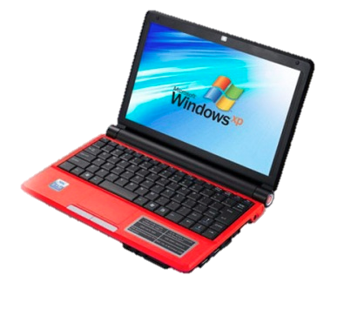
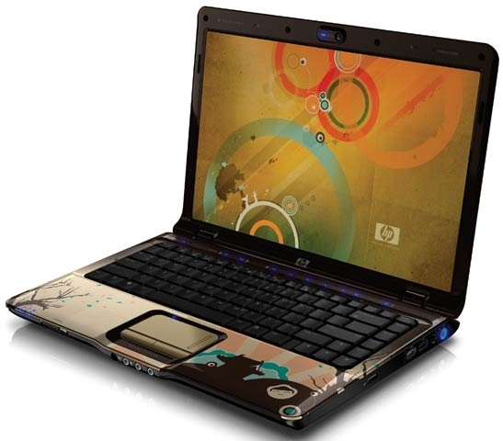
Bring Laptop!
Bring your Linux system to exam!

